Slide 1
Big Data – Amazon Web Services Week 11
Professor Arturo Castellanos, PhD
Assistant Professor – William & Mary
Big Data - MSBA

Slide 2
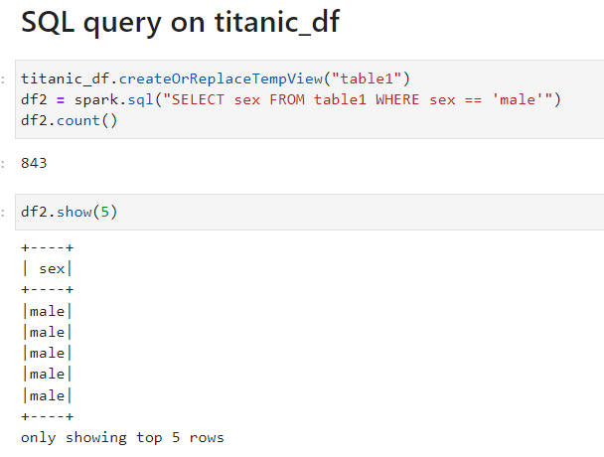

Executing SQL Queries
Check out the Google Colab notebook!
The SparkSession provides a method called sql which can be used to execute a SQL query.
The sql method takes a SQL statement as an argument and returns a DataFrame representing the result of the given query.
Unfortunately, SQL queries cannot be run directly against a DataFrame. To issue SQL queries against an existing DataFrame we can leverage the createOrReplaceTempView function to build a temporary table
After creating the temporary table, we can simply use the sql method, which allows us to write SQL code to manipulate data within a DataFrame.

Slide 3
Executing SQL Queries
The SparkSession provides a method called sql which can be used to execute a SQL query.
The sql method takes a SQL statement as an argument and returns a DataFrame representing the result of the given query.
Unfortunately, SQL queries cannot be run directly against a DataFrame. To issue SQL queries against an existing DataFrame we can leverage the createOrReplaceTempView function to build a temporary table
After creating the temporary table, we can simply use the sql method, which allows us to write SQL code to manipulate data within a DataFrame.

Slide 4
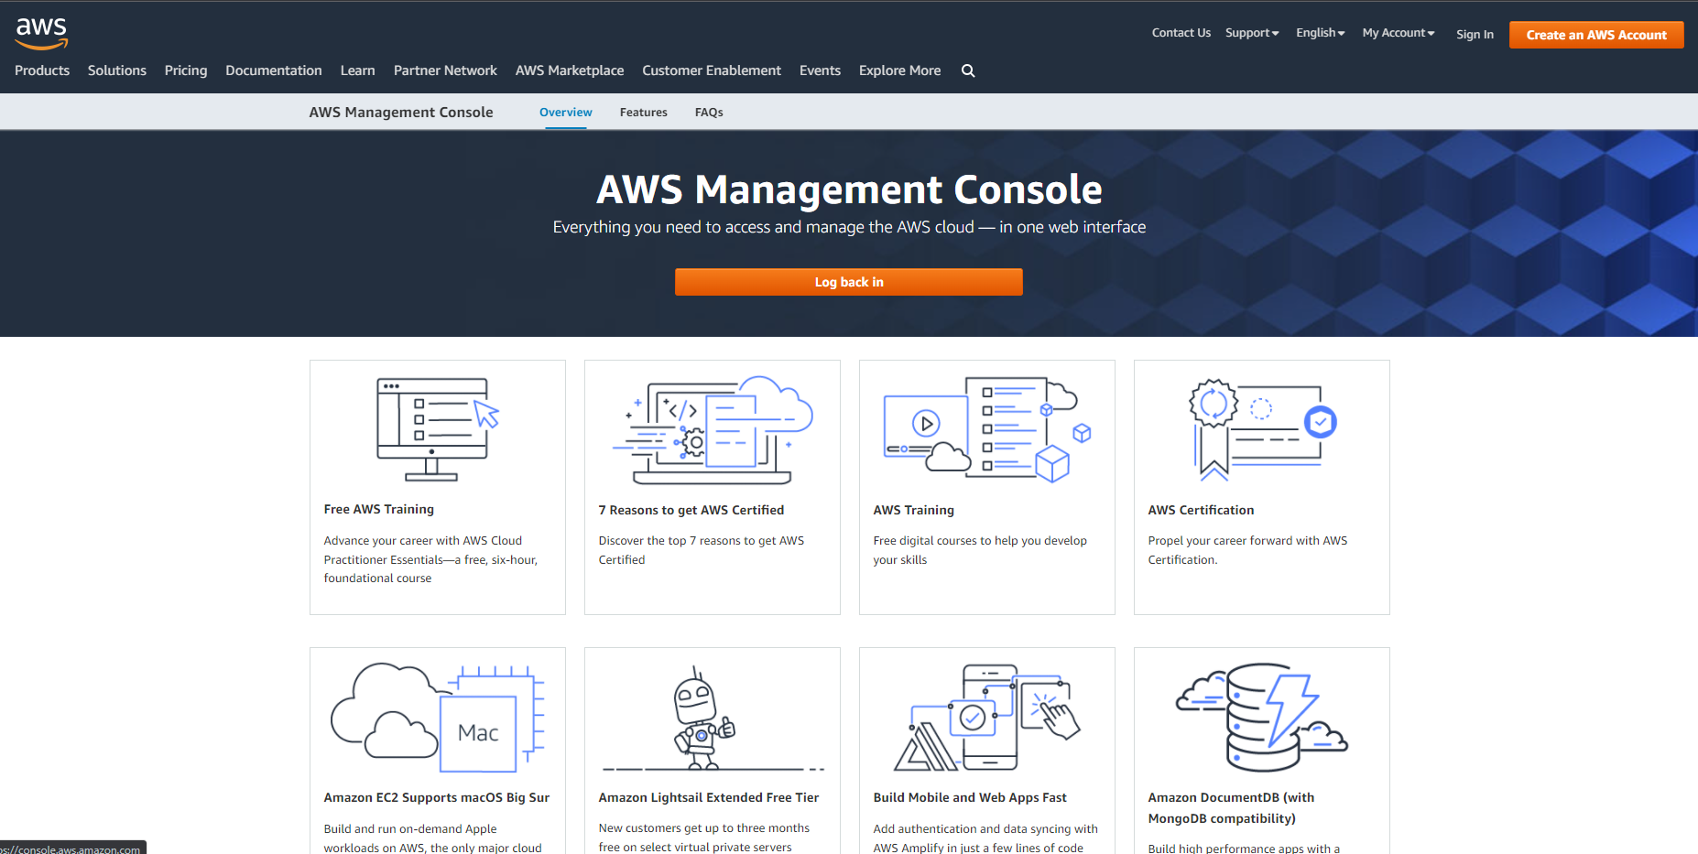
aws.amazon.com

Slide 5
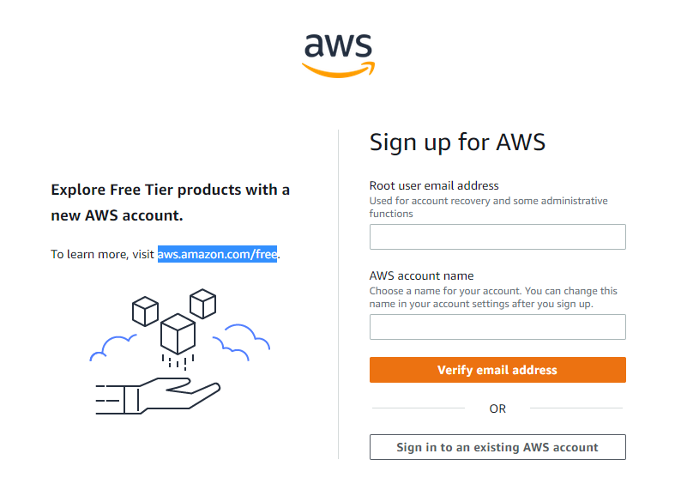

Slide 6
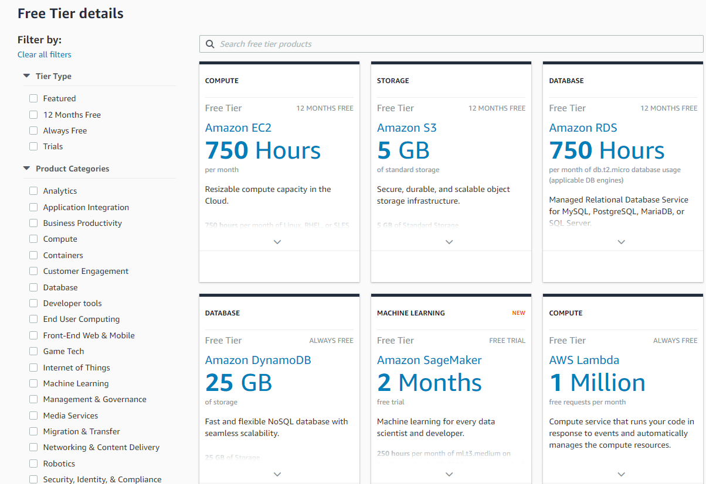

Slide 7
What we have done so far
Interacting with an API
Requesting a Key
Look at the documentation for endpoints
Use pandas to shape the data and select what you need
Working with AWS S3 (Simple Storage Service)
Getting your keys
Creating a bucket in S3
Listing the buckets in S3
Saving data into S3
Retrieving data from S3

Slide 8
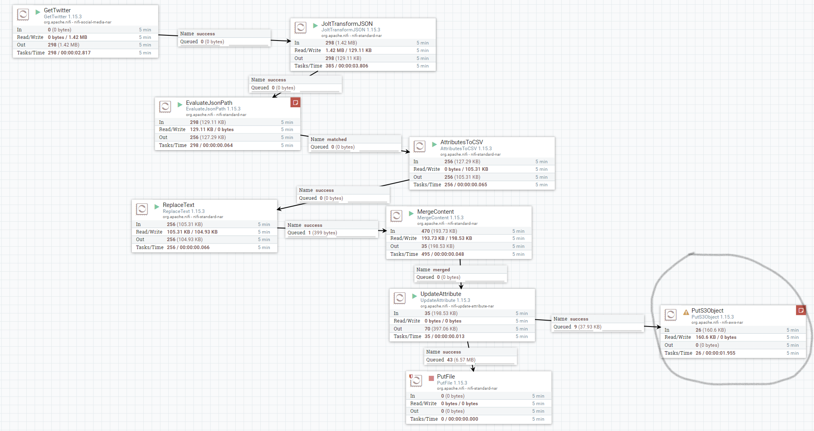
Nifi

Slide 9
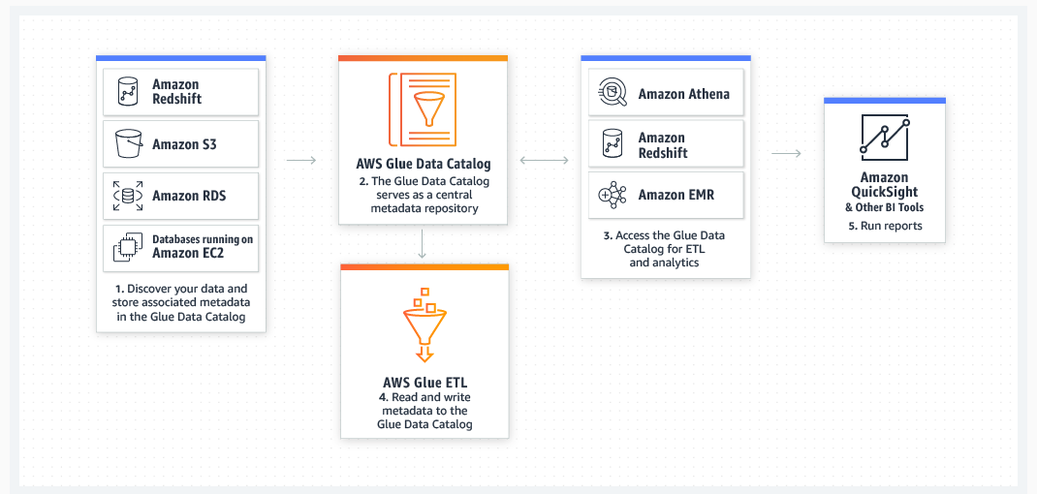
AWS GLUE
Data integration is the process of preparing and combining data for analytics, machine learning, and application development. It involves multiple tasks, such as discovering and extracting data from various sources; enriching, cleaning, normalizing, and combining data; and loading and organizing data in databases, data warehouses, and data lakes.

Slide 10
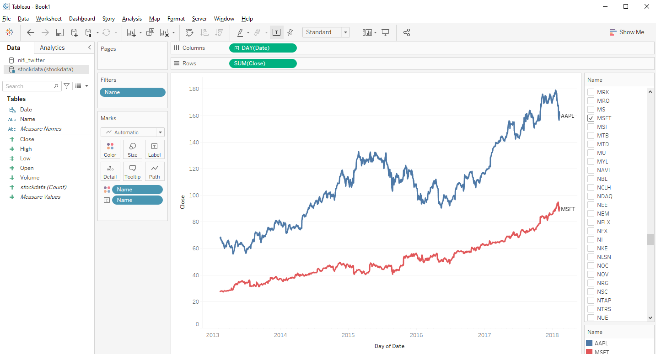

Slide 11
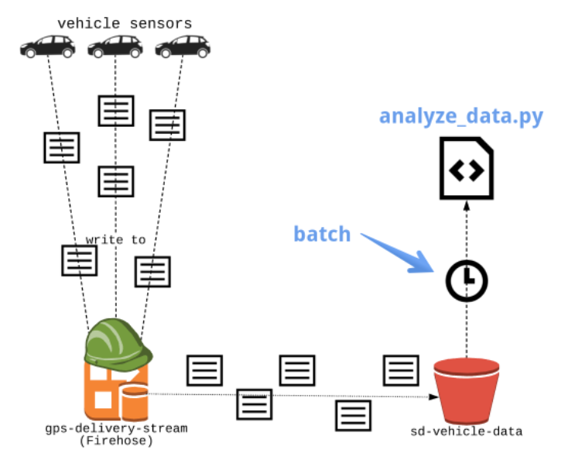
Source: From assigned Datacamp module on AWS Kinesis

Slide 12
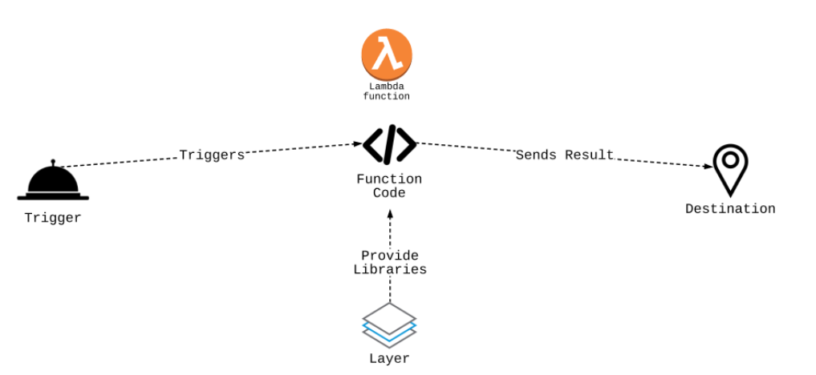
Source: From assigned Datacamp module on AWS Kinesis

Slide 13
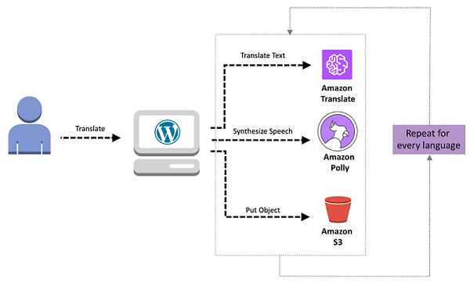
Amazon Translate
Source: https://aws.amazon.com/blogs/machine-learning/use-amazon-translate-to-create-multilingual-content-on-wordpress-sites/

Slide 14
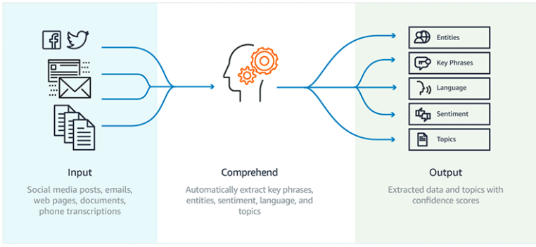
Amazon Comprehend
Source: https://aws.amazon.com/blogs/machine-learning/analyze-content-with-amazon-comprehend-and-amazon-sagemaker-notebooks/

Slide 15
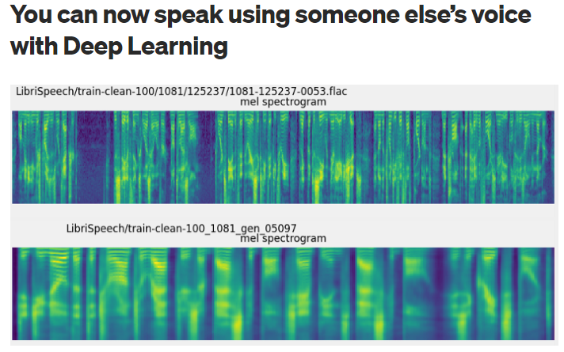
Source: https://towardsdatascience.com/you-can-now-speak-using-someone-elses-voice-with-deep-learning-8be24368fa2b
Video

Slide 16
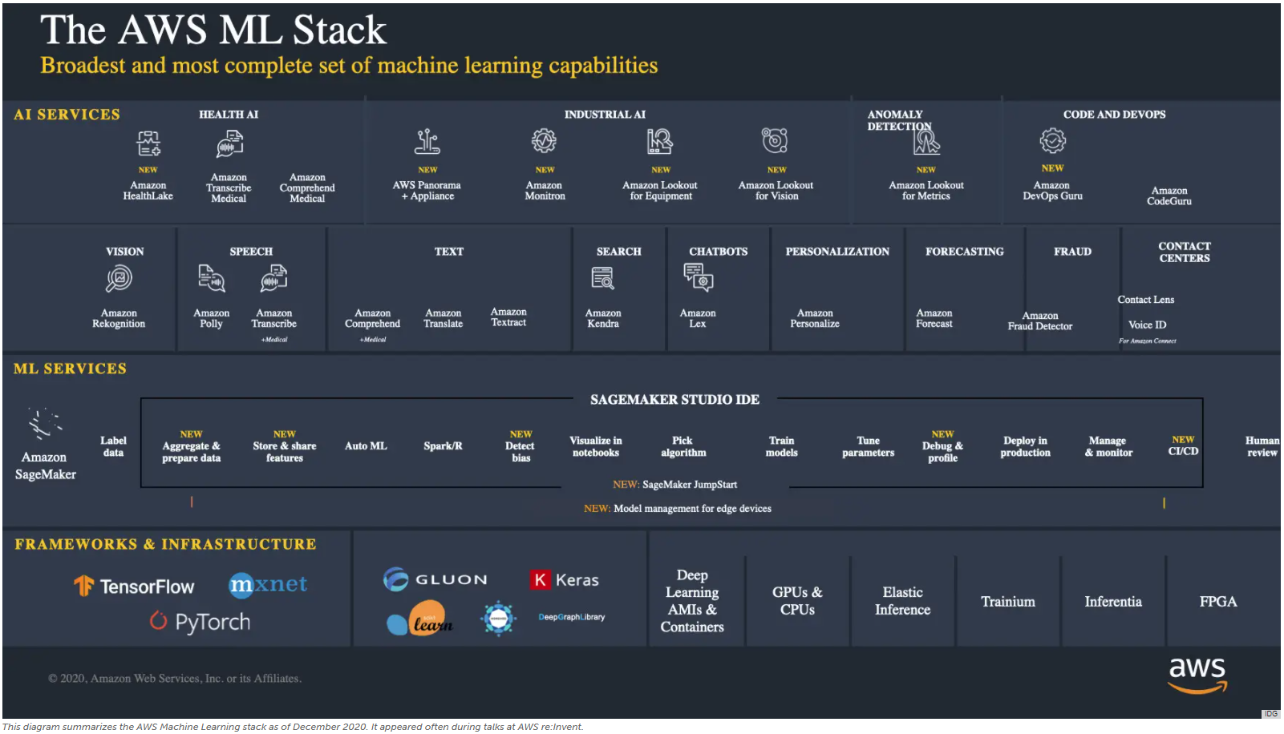

Slide 17
Next Class
Machine learning with Spark
Group project?
Is there anything I can help with?
Something you would like me to cover.

